Slide 1

Library Carpentry workshop - Day 1
Aston University, 5th June 2026

Slide 2
CODE OF CONDUCT
By participating in this community, participants accept to abide by The Carpentries’ Code of Conduct and accept the procedures by which any Code of Conduct incidents are resolved. Any form of behaviour to exclude, intimidate, or cause discomfort is a violation of the Code of Conduct. In order to foster a positive and professional learning environment we encourage the following kinds of behaviours in all platforms and events:
Use welcoming and inclusive language
Be respectful of different viewpoints and experiences
Gracefully accept constructive criticism
Focus on what is best for the community
Show courtesy and respect towards other community members
https://docs.carpentries.org/policies/coc/

Slide 3
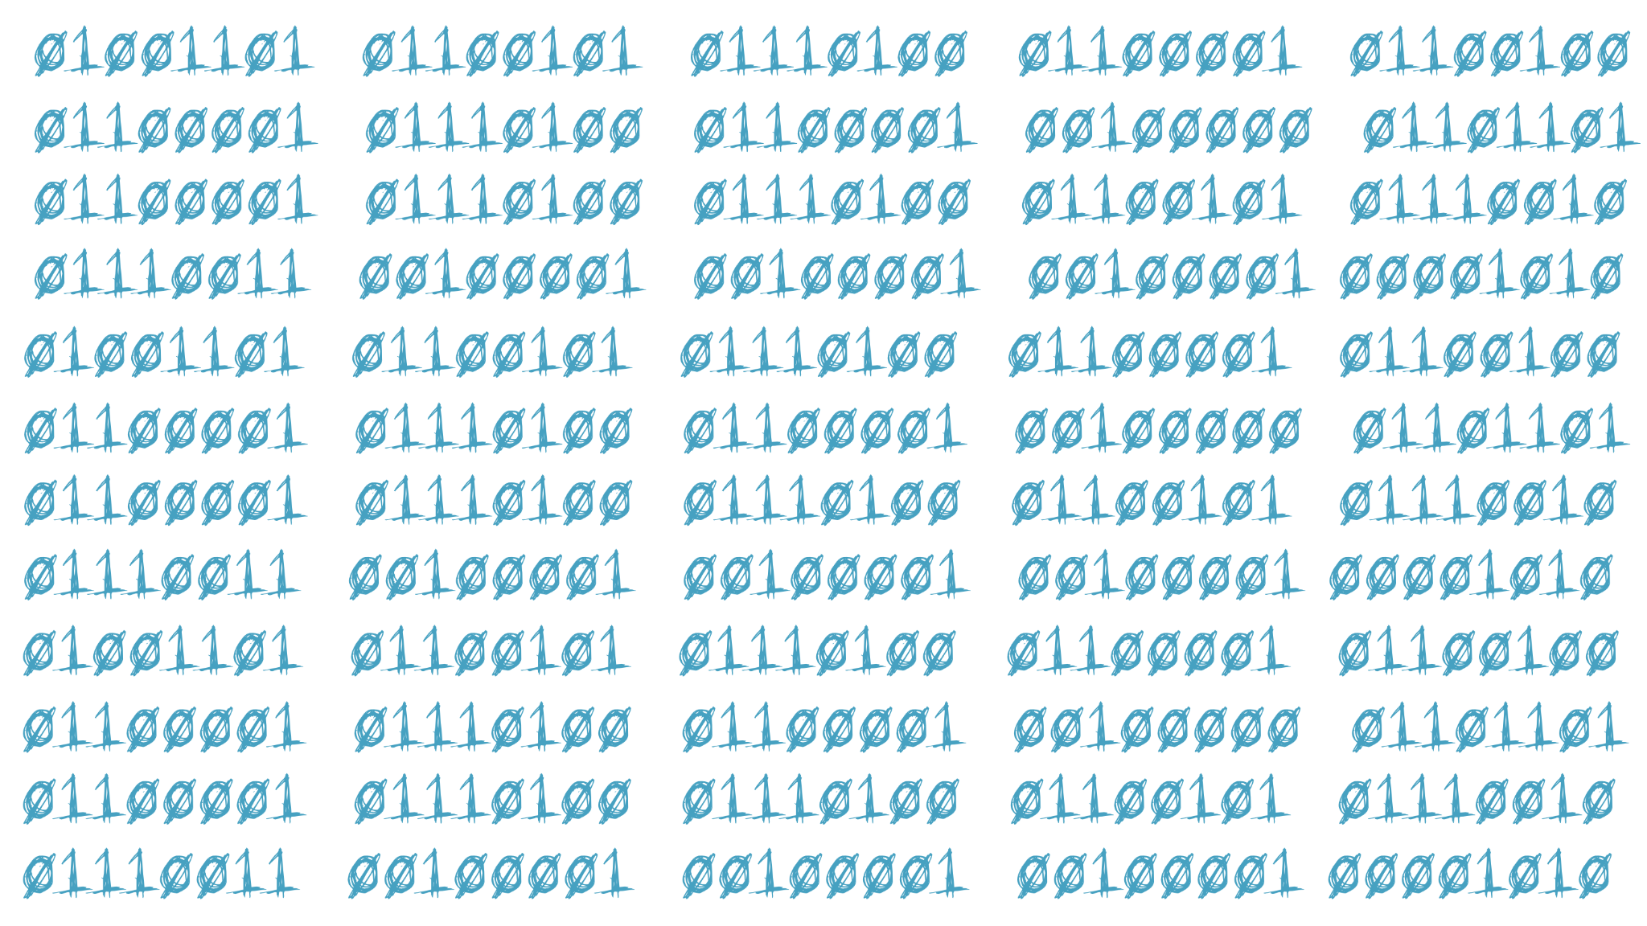
Data types, encodings and formats

Slide 4
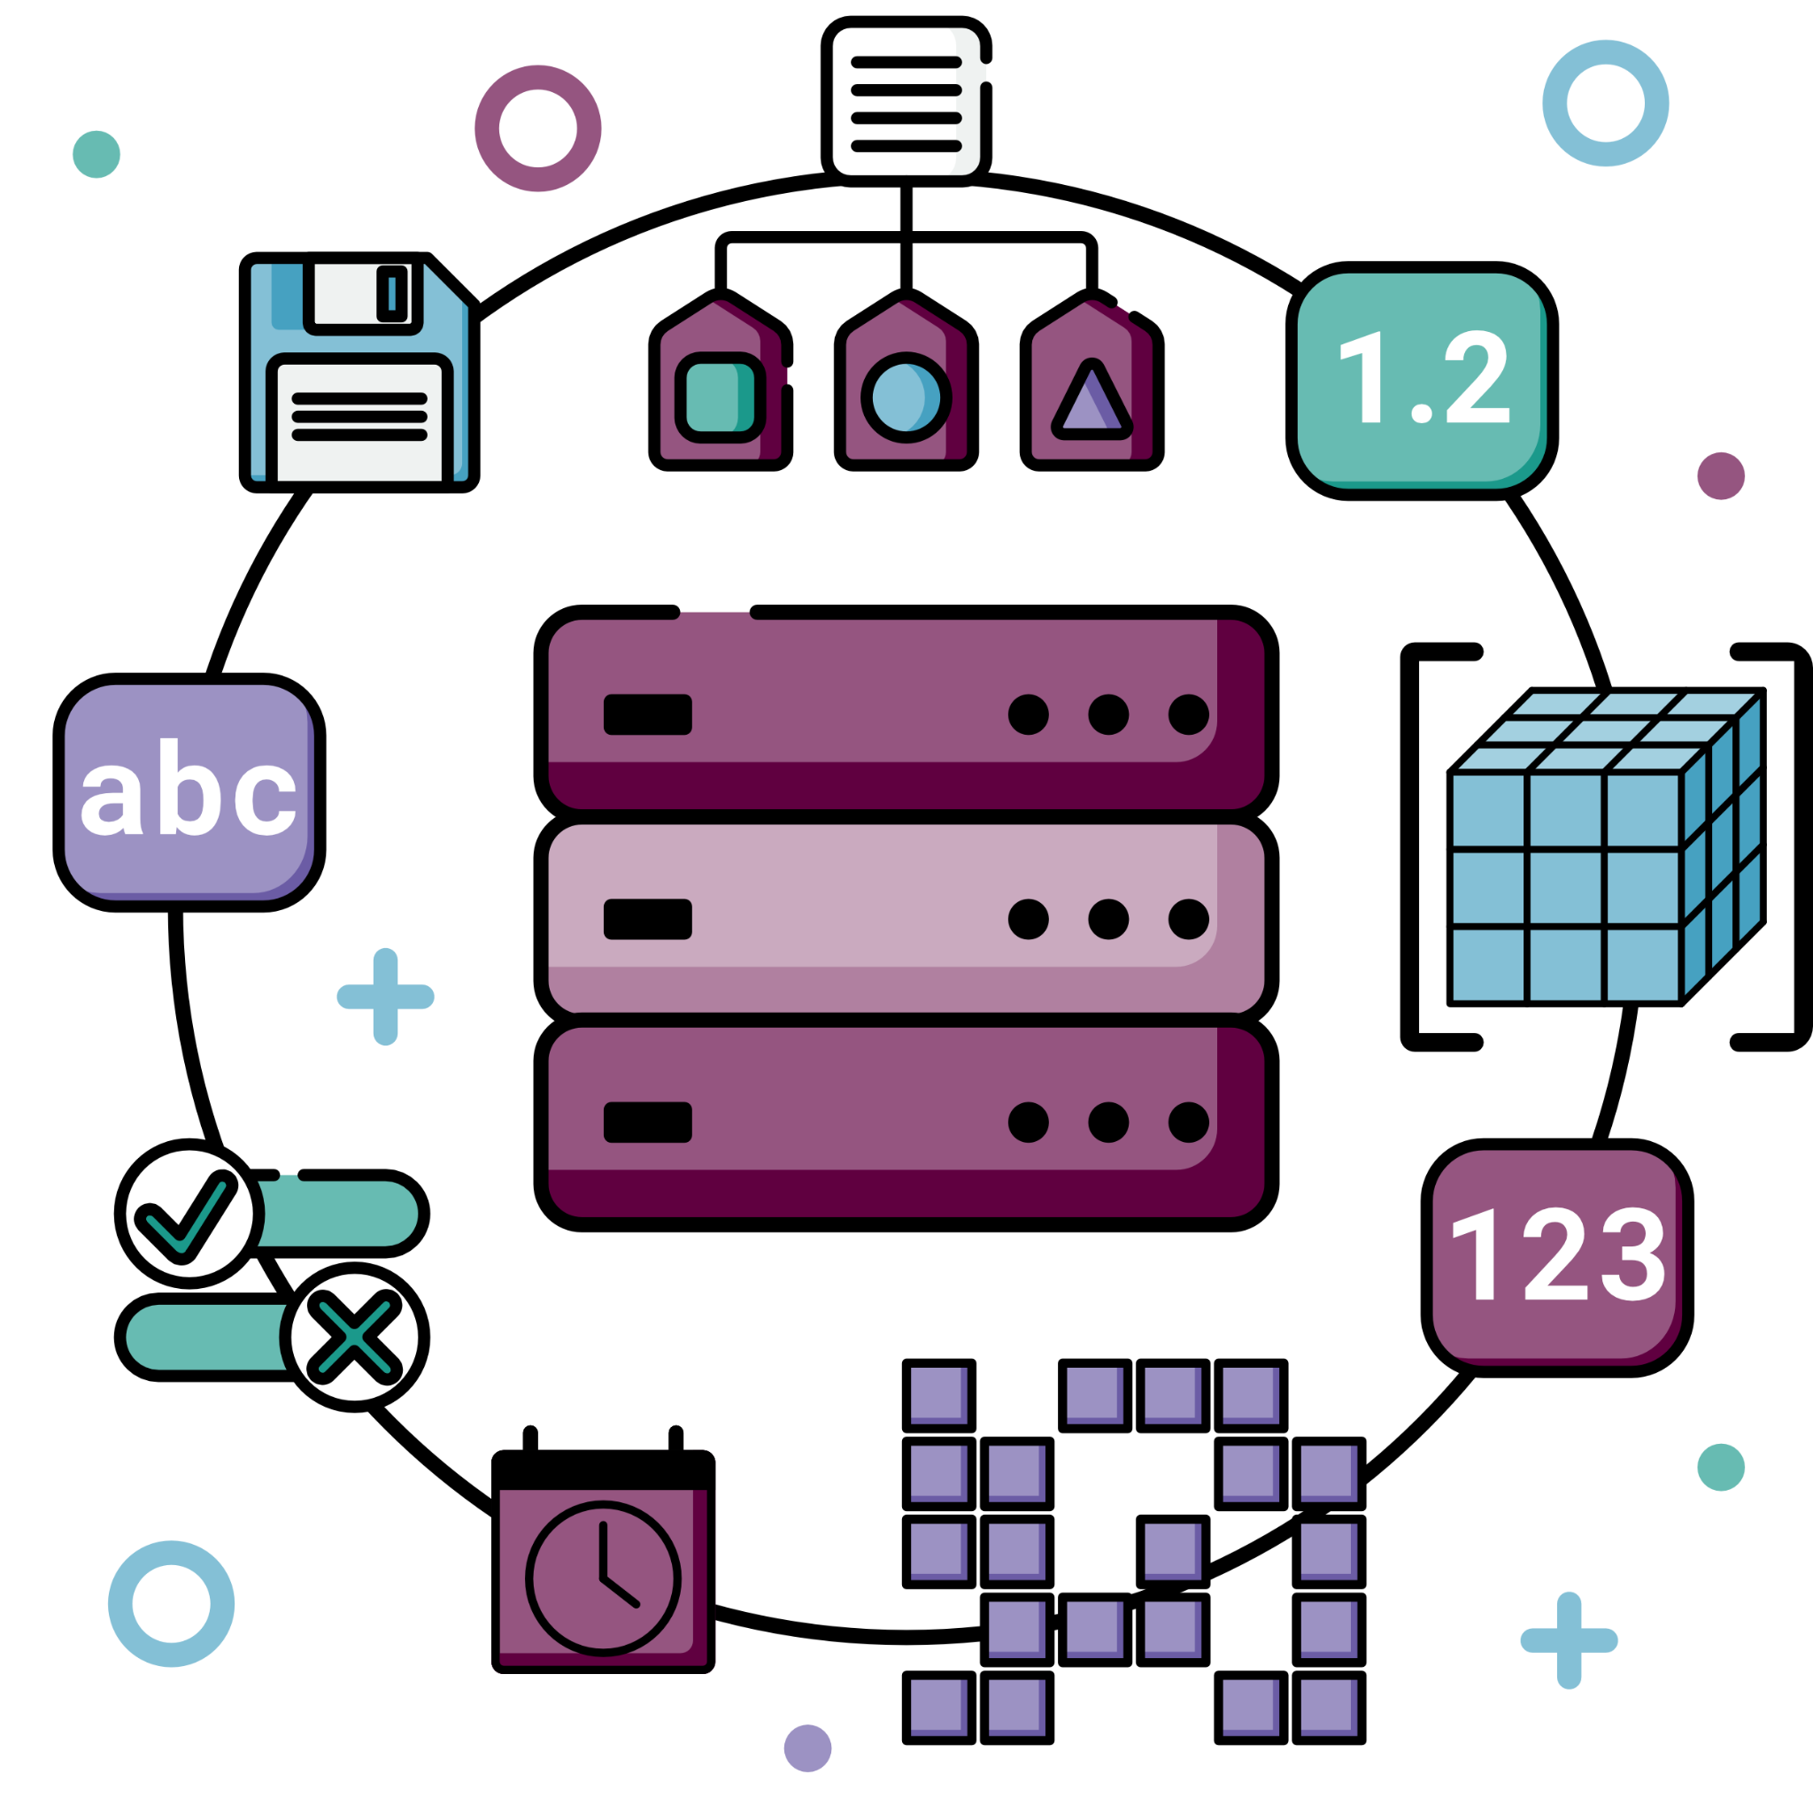
Data types and structures

Slide 5
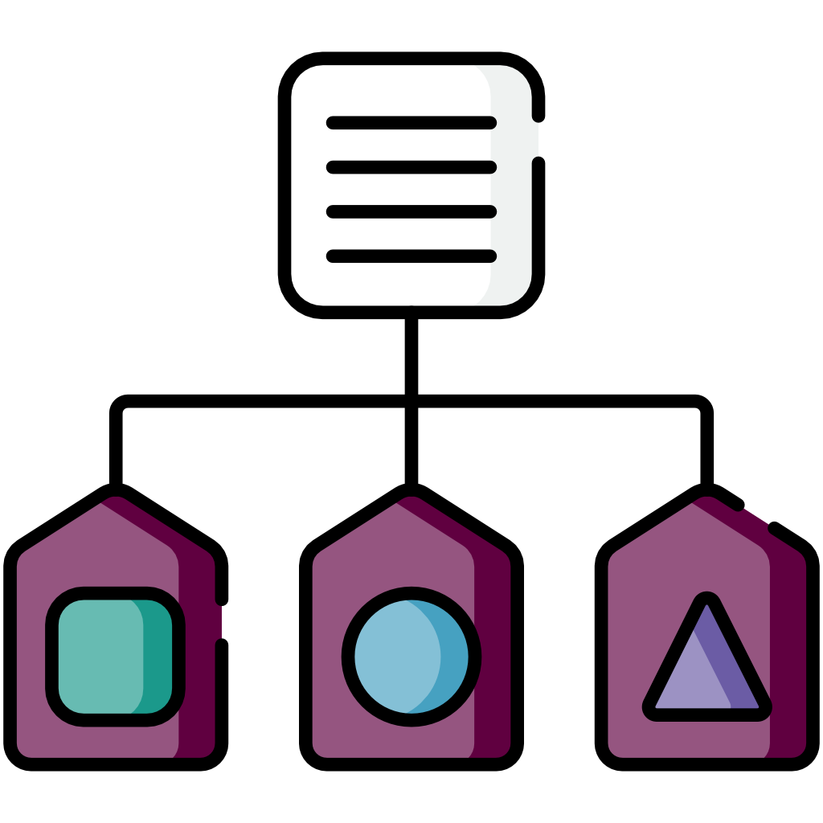




WHAT ARE DATA TYPES?
classification of values
defines how the value can be manipulated and which operations can be performed with it (i.e. what you can do with it)
defines restrictions on the value: its range (e.g. the value must be a number)
optimise memory & storage usage
error prevention
tells the computer how to interpret and store a value
Notes:
+ organisation
‘Data type’ (2026) Wikipedia. Available at: https://en.wikipedia.org/wiki/Data_type [Accessed: 24 May 2026]

Slide 6



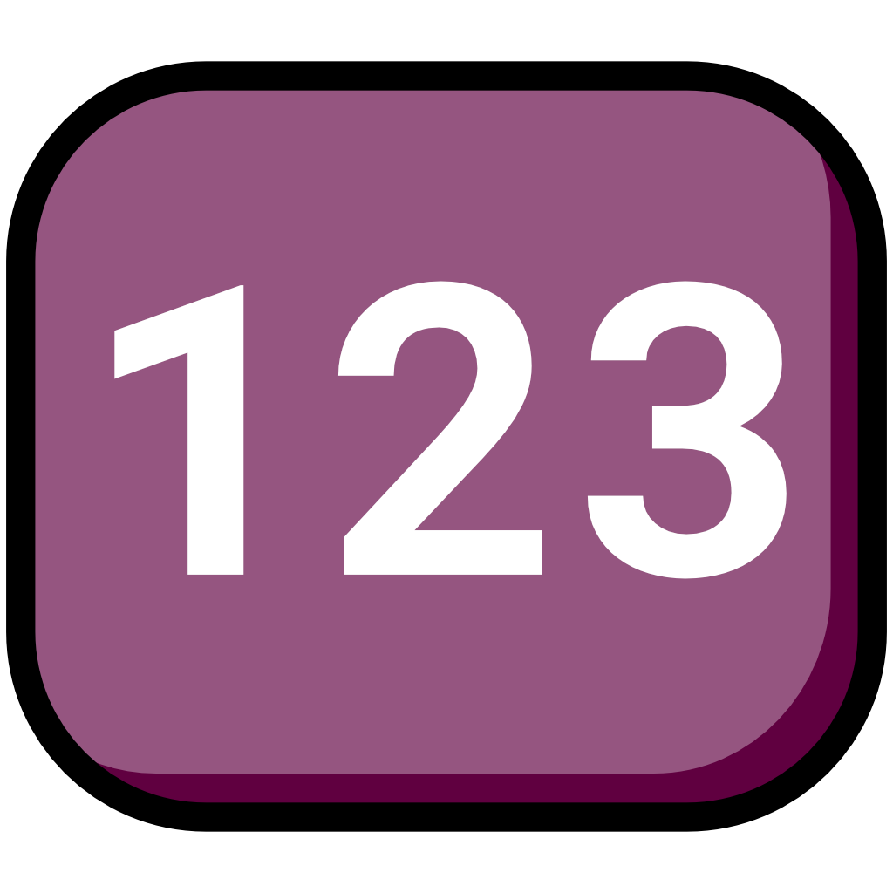
COMMON DATA TYPES
Definitions of data structures vary between languages! These are generic definitions. Always check the documentation!
string = text (sequence of characters)
Some languages have a char data type, which is a single character.
usually enclosed in “ “
strings can contain numbers, e.g. “user1”, “9 Broad St”, “1234”
integer = full number
long and short are also used, defining integer larger or smaller integer ranges to save space
concrete range varies between languages
e.g. 0, 20, 10000, -5
Notes:
Primitive data types: basic ones from which all others are constructed (they vary between languages)
Composite data types/data structures/struct: made up of primitives
User defined data types
Strings: sequence of characters; letters, digits, punctuation etc.
Short in C, C++ and C#: -32,727 to 32,767
Long in C and C#: −(2⁶³ − 1) to (2⁶³ − 1)
Long in C++: −(2³¹) to (2³¹ − 1)
‘Integer (computer science)’ (2026) Wikipedia. Available at: https://en.wikipedia.org/wiki/Integer_(computer_science) [Accessed: 24 May 2026]
‘Data type’ (2026) Wikipedia. Available at: https://en.wikipedia.org/wiki/Data_type [Accessed: 24 May 2026]

Slide 7
COMMON DATA TYPES
Definitions of data structures vary between languages! These are generic definitions. Always check the documentation!
string = text (sequence of characters)
Some languages have a char data type, which is a single character.
usually enclosed in “ “
strings can contain numbers, e.g. “user1”, “9 Broad St”, “1234”
integer = full number
long and short are also used, defining integer larger or smaller integer ranges to save space
concrete range varies between languages
e.g. 0, 20, 10000, -5
Notes:
Primitive data types: basic ones from which all others are constructed (they vary between languages)
Composite data types/data structures/struct: made up of primitives
User defined data types
Strings: sequence of characters; letters, digits, punctuation etc.
Short in C, C++ and C#: -32,727 to 32,767
Long in C and C#: −(2⁶³ − 1) to (2⁶³ − 1)
Long in C++: −(2³¹) to (2³¹ − 1)
‘Integer (computer science)’ (2026) Wikipedia. Available at: https://en.wikipedia.org/wiki/Integer_(computer_science) [Accessed: 24 May 2026]
‘Data type’ (2026) Wikipedia. Available at: https://en.wikipedia.org/wiki/Data_type [Accessed: 24 May 2026]

Slide 8
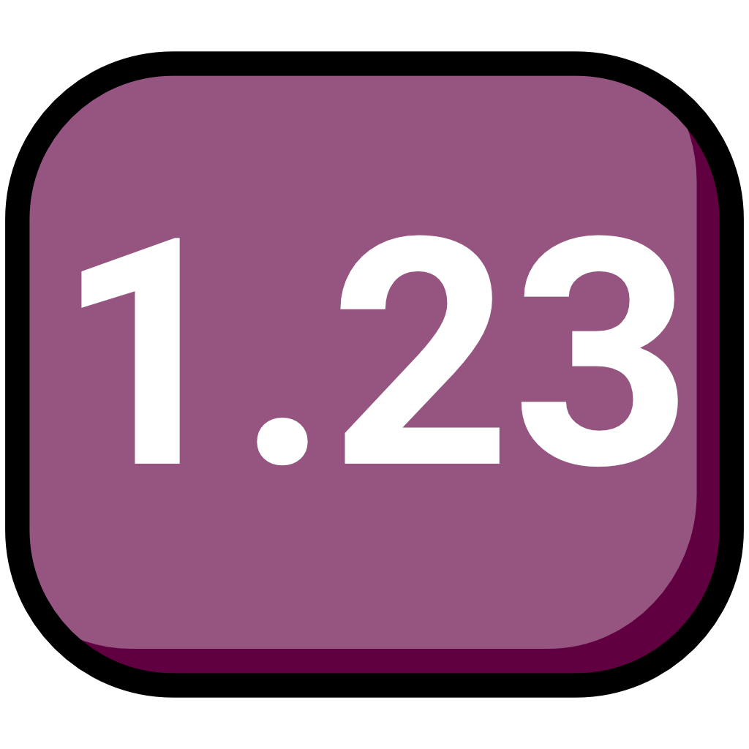
COMMON DATA TYPES
Definitions of data structures vary between languages! These are generic definitions. Always check the documentation!
float = number with decimal points
float and double are sometimes called real.
less precise (approx. 7 decimal digits)
smaller range
uses less space (32 bits)
double = number with decimal points
more precise (approx. 15 decimal digits)
larger range
uses more space (64 bits)
Notes:
Float: range approx 1.4E-45 (a digit with 45 zeros) to 3.4E+38
Double: range approx 4.9E-324 to 1.8E+308
‘Data type’ (2026) Wikipedia. Available at: https://en.wikipedia.org/wiki/Data_type [Accessed: 24 May 2026]
Chornyi, Andrii (2024) ‘Float vs Double: a comprehensive guide’, Codefinity blog, August. Available at: https://codefinity.com/blog/Float-vs-Double [Accessed: 24 May 2026]

Slide 9

COMMON DATA TYPES
Definitions of data structures vary between languages! These are generic definitions. Always check the documentation!
boolean = true or false
often an integer subtype with range 0 and 1
Notes:
Boolean: are more often represented as a byte or word rather as a single bit as it requires more machine instructions to store and retrieve an individual bit. Many programming languages do not have an explicit Boolean type, instead using an integer type and interpreting (for instance) 0 as false and other values as true.
‘Data type’ (2026) Wikipedia. Available at: https://en.wikipedia.org/wiki/Data_type [Accessed: 24 May 2026]

Slide 10

DATA STRUCTURES
Definitions of data structures vary between languages! These are generic definitions. Always check the documentation!
collections of data values, their relationships and the functions or operations that can be used with them
array
list
record/tuple
hash tables/maps
stacks and queues
graphs
trees
…
Notes:
Tuple: collection of values in fixed number and sequence
Hash maps: key value pairs
Stacks: first in first out, add at the same end as remove
Queue: last in first out, add and pop at opposite ends
Tree: hierarchical organisation of elements
Graphs : collections of nodes connected by edges, representing relationships between entities
‘Data structure’ (2026) Wikipedia. Available at: https://en.wikipedia.org/wiki/Data_structure [Accessed: 24 May 2026]

Slide 11
ARRAY
Definitions of data structures vary between languages! These are generic definitions. Always check the documentation!
a collection of values in a specific order
In some language once the length of the array is defined it cannot be changed, i.e. you cannot add more values than you initially allowed space for
a | b | c | d | e |  | g | h | i
a | b | c | d | e | f | g | h | i
1 | 2 | 3 | 4 | 5 | 6 | 7 | 8 | 9
1 | 2 | 3 | 4 | 5 | 6 | 7 | 8 | 9
0 | 1 | 2 | 3 | 4 | 5 | 6 | 7 | 8
Closing the gap would require reassigning all following values to a different index
⬇
index
[“a”, “b”, “c”, “d”, “e”, “f”, “g”, “h”, “i”]
[1,4,7,10,16,11,5]
Some definition allow for values to be of different types
[“Susi”, “Fran”, 15, “Ann”, 10.5, -9]
Notes:
Indexes starting in 1 do exist, but mostly it’s 0
This is one-dimensional array, multi-dimensional arrays exist
‘Array (data structure)’ (2026) Wikipedia. Available at: https://en.wikipedia.org/wiki/Array_(data_structure) [Accessed: 24 May 2026]

Slide 12
LIST OR LINKED LIST
Definitions of data structures vary between languages! These are generic definitions. Always check the documentation!
a linear collection of nodes
A list where a node also points to be previous value is called a doubly linked list
a node has a value and points to the next node
26
⏺
59
18
⏺
26
⏺
59
⏺
18
⏺
node
terminator
59
⏺
59
26
26
⏺
⏺
18
18
⏺
⏺

Slide 13
HASH MAP OR DICTIONARY
Definitions of data structures vary between languages! These are generic definitions. Always check the documentation!
maps keys to values using a hash function
keys
Hash function
values
00 | Duncan
01 | 5
02 | Izzy
03 | bengal
⋮ | ⋮
25 | 10
26 | moggy
27 | 2
name: Izzy
age: 5
breed: moggy
Duncan
5
Izzy
bengal
⋮
10
moggy
2
{
“name”: “Izzy,
“age”: 5,
“breed”: “moggy”
}
name
age
name=Izzy
age=5
breed=moggy
breed
Notes:
Simplification
Other commonly included data types such as date, time, datetime
‘Hash table’ (2026) Wikipedia. Available at: https://en.wikipedia.org/wiki/Hash_table [Accessed: 24 May 2026]

Slide 14
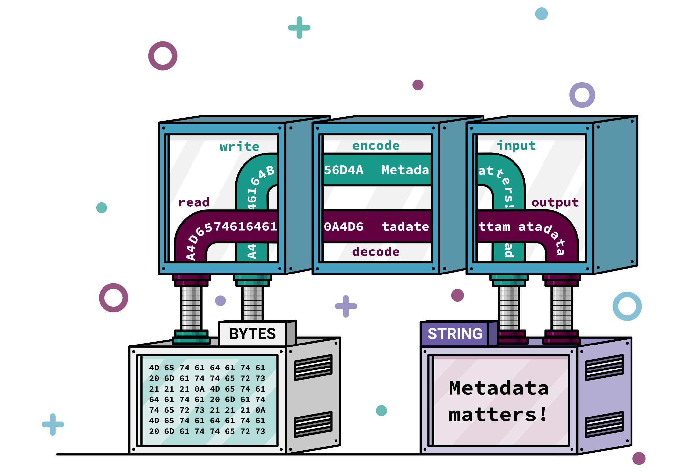
Data encoding

Slide 15
ENCODING - WHY ARE WE TALKING ABOUT IT?
Because:
FriÃ°rikka RÃºnarsdÃ³ttir
Â©2020
fÃ¼nf sÃ¼ÃŸe FÃ¼chse
ÐœÐµÑ‚Ð°Ð´Ð°Ð½Ð½Ñ‹Ðµ Ð¸Ð¼ÐµÑŽÑ‚ Ð·Ð½Ð°Ñ‡ÐµÐ½Ð¸Ðµ
ë©”íƒ€ë°ì´í„°ê°€ ì¤‘ìš”í•©ë‹ˆë‹¤
Notes:
Mojibake
‘Mojibake’ (2026) Wikipedia. Available at: https://en.wikipedia.org/wiki/Mojibake [Accessed: 24 May 2026]

Slide 16
ENCODING - WHY ARE WE TALKING ABOUT IT?
Friðrikka Rúnarsdóttir
©2020
fünf süße Füchse
Метаданные имеют значение
메타데이터가 중요합니다

Slide 17
CODE, ENCODING AND DECODING
code /kəʊd/, noun
A method of communication in which each letter (or group of letters) in a written message is systematically substituted by another, or by a symbol, to enable transmission
Computing. Any system of symbols and rules for expressing information or instructions in a form usable by a computer or other digital machine for processing or transmitting information. Also: information or instructions written according to such a system.
encode /ɛnˈkəʊd/, verb
to translate into cipher or code
decode /(ˌ)diːˈkəʊd/, verb
to decipher or translate (a coded message)
Notes:
‘code, n., sense II.4.b’ (2026) in Oxford English Dictionary. Available at: https://doi.org/10.1093/OED/1750064856 [Accessed: 24 May 2026]
‘code, n., sense II.7’ (2026) in Oxford English Dictionary. Available at: https://doi.org/10.1093/OED/8027718018 [Accessed: 24 May 2026]
‘decode, v.’ (2025) in Oxford English Dictionary. Available at: https://doi.org/10.1093/OED/3318848028 [Accessed: 24 May 2026]
‘encode, v.’ (2025) in Oxford English Dictionary. Available at: https://doi.org/10.1093/OED/7215232060 [Accessed: 24 May 2026]

Slide 18



WHAT IS CHARACTER ENCODING?
letters, numbers, punctuation marks etc. are visualised by characters
a file saved using character set A and read using set B maps the bytes to the wrong characters → garbled nonsense
characters are stored as one or more bytes
a mapping between the the byte(s) representing the character and its visual representation is needed → character set
there are a lot of different character sets
Notes:
‘Character encoding’ (2026) Wikipedia. Available at: https://en.wikipedia.org/wiki/Character_encoding [Accessed: 24 May 2026]
Ishida, Richard (2018) Character encodings: Essential concepts. Available at: https://www.w3.org/International/articles/definitions-characters/ [Accessed: 24 May 2026]
Ishida, Richard (2020) Character encodings for beginners. Available at: https://www.w3.org/International/questions/qa-what-is-encoding [Accessed: 24 May 2026]
Ishida, Richard (2024) Character Sets and Encodings. Available at: https://www.w3.org/International/getting-started/characters [Accessed: 24 May 2026]

Slide 19
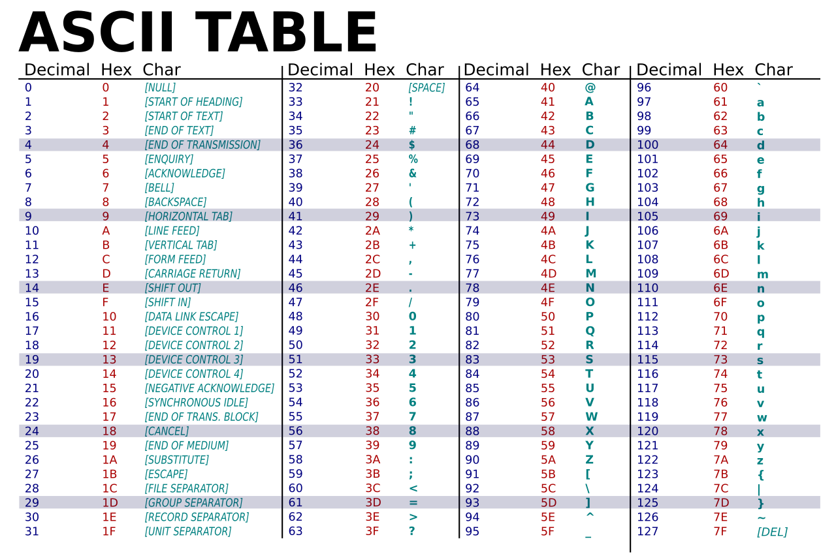
Notes:
American Standard Code for Information Interchange, first published 1963 (1967 major revision, further revisions until 1986)
95 printable, 33 non–printing control codes
Record Separator (terminate directory and each variable field) RS
Group Separator (final character of record) GS
Unit Separator (subfield) US
‘ASCII’ (2026) Wikipedia. Available at: https://en.wikipedia.org/wiki/ASCII [Accessed: 24 May 2026]
MrAureliusR (2025) ASCII-Table-wide.svg. Available at: https://commons.wikimedia.org/wiki/File:ASCII-Table-wide.svg [Accessed: 24 May 2026]
Library of Congress Network Development and MARC Standards Office (2000) MARC 21 Specification for Record Structure, Character Sets, and Exchange Media. Available at: https://www.loc.gov/marc/specifications/spechome.html [Accessed: 24 May 2026]

Slide 20




UNICODE
The default encoding scheme in Windows is Windows-1252 (also called CP-1252).
Unicode is huge (close to 160,000 characters)
characters needed for 172 living and ancient scripts
numbers, punctuation, symbols, emojis, arrows, blocks, geometric shapes…
can be expressed in UTF-8, UTF-16 and UTF-32
the difference is how many bytes are used for character storage
UTF-32 always uses 4 bytes to store a character (fixed width); UTF-16 and UTF-8 use as few bytes as possible (variable width)
UTF-8 is most efficient for Latin text and ASCII compatible
byte
0
1
1
0
1
1
1
1
= o
bit
= o
0
0
0
0
0
0
0
0
0
1
1
0
1
1
1
1
0
0
0
0
0
0
0
0
0
0
0
0
0
0
0
0
0
0
0
0
0
0
0
0
0
1
1
0
1
1
1
1
= o
Notes:
Full at ~1.1 million characters
UTF-8 is backward compatible with ASCII (first 128 characters are identical).
UTF-8: Standard for HTML, web, and Linux/Unix systems.
UTF-16: Used by Windows internally, Java, and .NET.
UTF-32: Used internally when quick indexing is critical, though rarely for transmission.
Basic Multilingual Plane (first 65,536 code point)
UTF-8 uses 1 byte to represent characters in the ASCII set, two bytes for characters in several more alphabetic blocks, and three bytes for the rest of the BMP. Supplementary characters use 4 bytes.
UTF-16 uses 2 bytes for any character in the BMP, and 4 bytes for supplementary characters.
UTF-32 uses 4 bytes for all characters.
https://codepoints.net/U+00F6
UTF-8 supported in Windows since Windows 10
‘Comparison of Unicode encodings’ (2026) Wikipedia. Available at: https://en.wikipedia.org/wiki/Comparison_of_Unicode_encodings [Accessed: 24 May 2026]
FAQ (no date) Available at: https://home.unicode.org/basic-info/faq/ [Accessed: 24 May 2026]
Ishida, Richard (2018) Character encodings: Essential concepts. Available at: https://www.w3.org/International/articles/definitions-characters/ [Accessed: 24 May 2026]
Supported Scripts (no date) Available at: https://www.unicode.org/standard/supported.html [Accessed: 24 May 2026]
‘Unicode’ (2026) Wikipedia. Available at: https://en.wikipedia.org/wiki/Unicode [Accessed: 24 May 2026]
Unicode Statistics (2025) Available at: https://www.unicode.org/versions/stats/ [Accessed: 24 May 2026]
‘UTF-8’ (2026) Wikipedia. Available at: https://en.wikipedia.org/wiki/UTF-8 [Accessed: 24 May 2026]

Slide 21

Data formats

Slide 22
DATA FORMATS
We’ll look at:
Tabular data (CVS, TSV)
Markup languages (XML)
JSON
Please open https://vscode.dev/ in your browser.
Notes:
Install rainbow-csv
Microsoft (2026) Visual Studio Code (browser version) [Computer programme]. Available at: https://vscode.dev/ [Accessed: 24 May 2026]
mechatroner (2026) Rainbow CSV [Computer programme]. Available at: https://marketplace.visualstudio.com/items?itemName=mechatroner.rainbow-csv [Accessed: 24 May 2026]

Slide 23

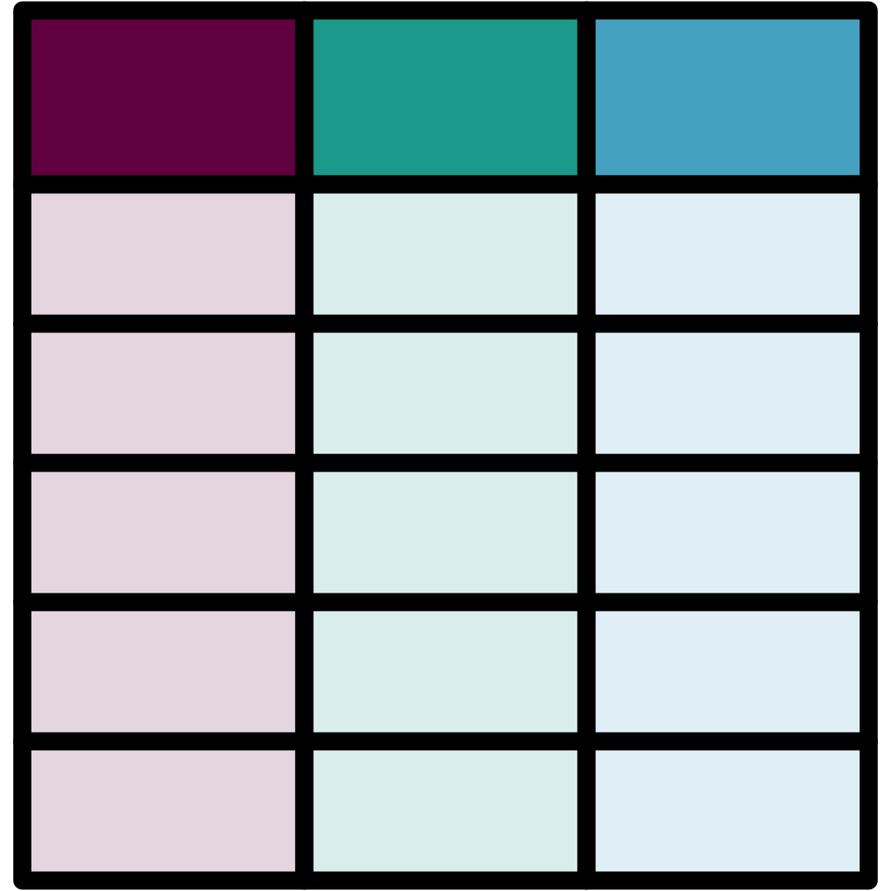


TABULAR DATA FORMATS (CSV, TSV)
plain text data formats
The character(s) used for newline depend(s) on your operating system.
Windows uses CR LF
Unix and Unix-like systems (like Linux or macOS) use LF
This can lead to problems when using files using the wrong newline character(s).
store tabular data (similar to a spreadsheet)
rows are separated by newline
columns are separated by delimiter
Comma-Separated Values = CSV = delimiter is comma
Tab-Separated Values = TSV = delimiter is tab
https://vscode.dev/
Notes:
MARC21 is a delimiter separated values format
https://vscode.dev/
‘Comma-separated values’ (2026) Wikipedia. Available at: https://en.wikipedia.org/wiki/Comma-separated_values [Accessed: 24 May 2026]
‘Delimiter’ (2026) Wikipedia. Available at: https://en.wikipedia.org/wiki/Delimiter [Accessed: 24 May 2026]
‘Delimiter-separated values’ (2026) Wikipedia. Available at: https://en.wikipedia.org/wiki/Delimiter-separated_values [Accessed: 24 May 2026]
‘Newline’ (2026) Wikipedia. Available at: https://en.wikipedia.org/wiki/Newline [Accessed: 24 May 2026]
Shafranovich, Yakov (2005) RFC 4180: Common Format and MIME Type for Comma-Separated Values (CSV) Files. Available at: https://doi.org/10.17487/RFC4180 [Accessed: 24 May 2026]
‘Tab-separated values’ (2026) Wikipedia. Available at: https://en.wikipedia.org/wiki/Tab-separated_values [Accessed: 24 May 2026]
‘Table (information)’ (2026) Wikipedia. Available at: https://en.wikipedia.org/wiki/Table_(information) [Accessed: 24 May 2026]
University of Minnesota Internet Gopher Team (no date) Definition of tab-separated-values (tsv). Available at: https://www.iana.org/assignments/media-types/text/tab-separated-values [Accessed: 24 May 2026]

Slide 24
NAMESPACES
boxes that keep identifiers from different schemes separate
prevent conflicts between identifiers with the same name
ensure identifiers are unique
Notes:
If you use an element defined elsewhere, this elsewhere usually has a web address. Prepend that to the element name and you have a **qualified element name**, i.e. you've given it a prefix that distinguishes it from other elements with the same name.
For example if one wanted to use elements defined in [MODS ](https://www.loc.gov/standards/mods/)(Metadata Object Description Schema)

Slide 25

NAMESPACES
namespace names are not prescribed, you can assign whatever you want, but https://www.w3.org/wiki/TheUsualPrefixes
lib: https://www.libraryxml.com/
shop: https://www.shopxml.com/
Library XML definition:
<book>...</book>
<book>...</book>
<lib:book>...</lib:book>
<shop:book>...</shop:book>
Bookshop XML definition:
<book>...</book>
Notes:
http://prefix.cc/popular/all.rdf
https://www.w3.org/TR/xmlschema11-1/#ns-bindings

