Slide 1
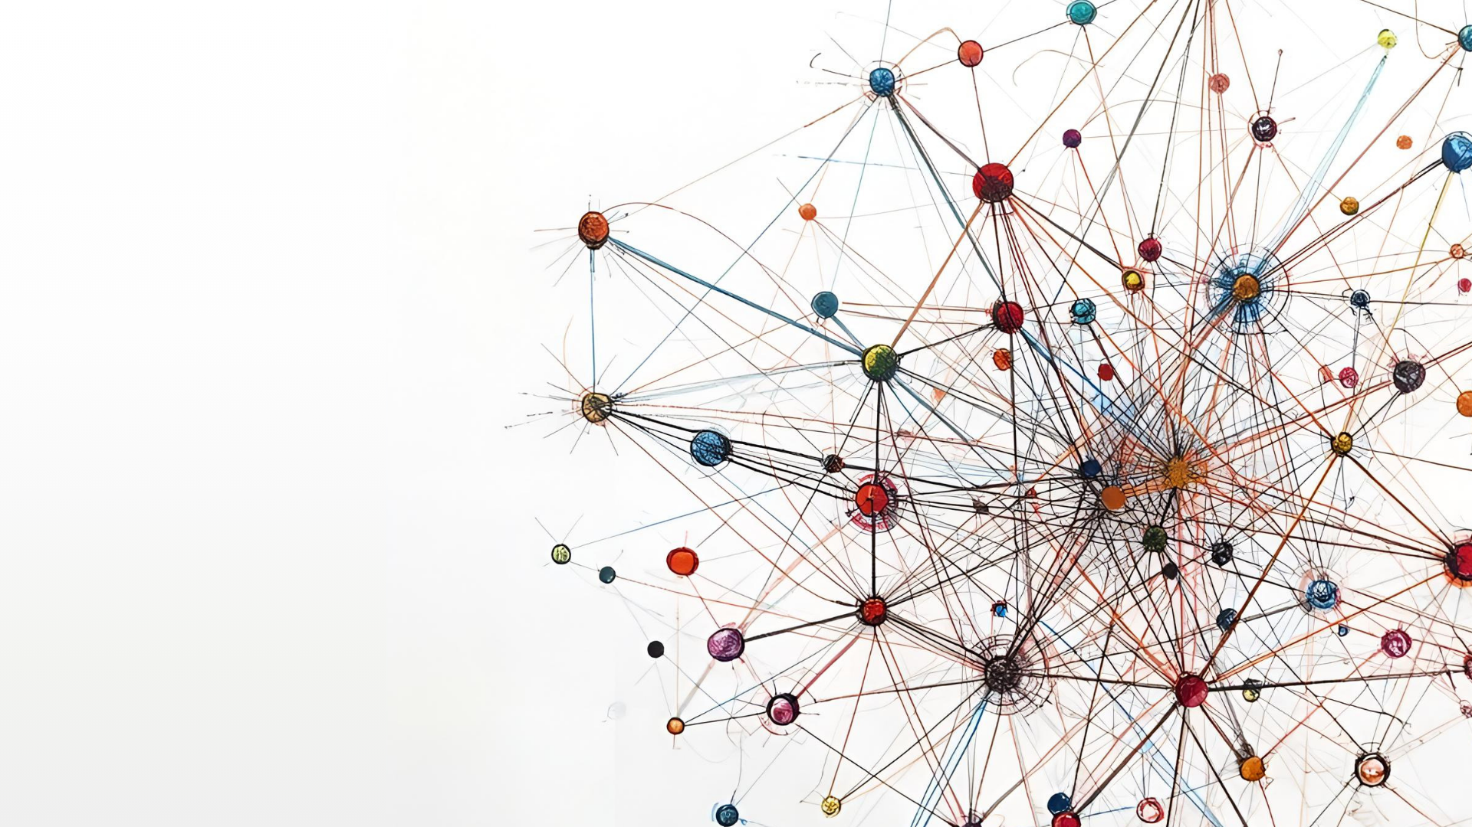

Library Carpentry workshop - Day 2
Open Refine
Aston University, 12th June 2026
Fran Frenzel
Metadata Analyst
The London School of Economics and Political Science

Slide 2
WHAT IS OPENREFINE?
“a power tool for working with messy data”
(David Huynh)

Slide 3
WHAT IS OPENREFINE?
Is most powerful with tabular data (e.g. CSV, TSV, spreadsheet) with
inconsistent data types and formats
inconsistencies in where data appears
inconsistent terminology

Slide 4
WHAT IS OPENREFINE?
It can help you to
get an overview of the dataset
standardise and clean data
split data into more granular parts
match local data against external datasets (e.g. Wikidata, VIAF)
enhance data with data from external/other sources

Slide 5
SOME BASICS ABOUT OPENREFINE
though it runs in a browser, you do not need an internet connection (except for remote reconciliation)
no data or commands are sent to a remote server (except for remote reconciliation)
files are saved locally, so if you work on two machines you will have to export/import files/projects
you are not modifying original/raw data
Projects are autosaved every 5 minutes and when shutting OpenRefine down

Slide 6

IMPORTING DATA
Start OpenRefine
http://127.0.0.1:3333/

Slide 7
WHERE DOES OPENREFINE STORE FILES?
Windows
Mac
Depending on the version, it’s one of these directories:
~/Library/Application\ Support/OpenRefine/
%appdata%\OpenRefine
%localappdata%\OpenRefine
C:\Documents and Settings\(user id)\Local Settings\Application Data\OpenRefine
C:\Users\(user id)\AppData\Roaming\OpenRefine
C:\Users\(user id)\AppData\Local\OpenRefine
C:\Users\(user id)\OpenRefine
For more info and how to change the data directory see https://openrefine.org/docs/manual/installing#set-where-data-is-stored

